Slide 1
Finding Potential Customer for Promocollection
Lie Zhou
Warehouse assistant
Promocollection Pty Australia

Slide 2
Outline
Introduction
Data acquistion and cleaning
Regression model
Cluster analysis
Cluster map with patient
Conclusion

Slide 3
Introduction
Why this project is important?
COVID-19 pandemic still exist
Warehouse overload with promotion goods
Re-opening restaurant facing threat from crowd people
Method for this project
Web scraping data collection
K-Mean Clustering analysis
Statistical correlation study

Slide 4
Data acquistion and cleaning
Demographic data for suburbs in Sydney (Population, age groups)
Geographic data for suburbs in Sydney (Coordinates)
Existed COVID-19 patient in Sydney (suburb, age group)
Venues for suburbs in Sydney

Slide 5
Regression model
Regression model suggest that there exist no linear relation between COVID-19 patient and population.
COVID-19 patient age group distribution suggest that adults(20~39) are as vulnerable to the virus as seniors(60+)

Slide 6
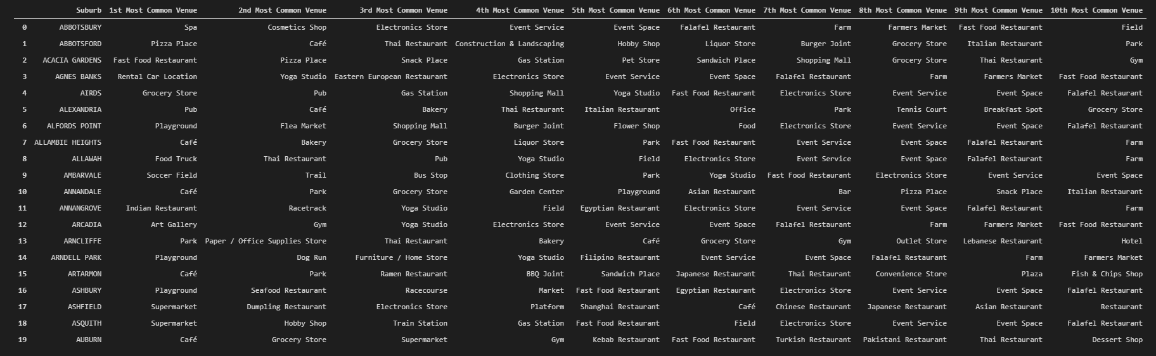
Cluster analysis
Select top 10 venues
Set up 4 clusters
K-mean based on venues
5 clusters in total
cluster 3 contains more restaurant

Slide 7
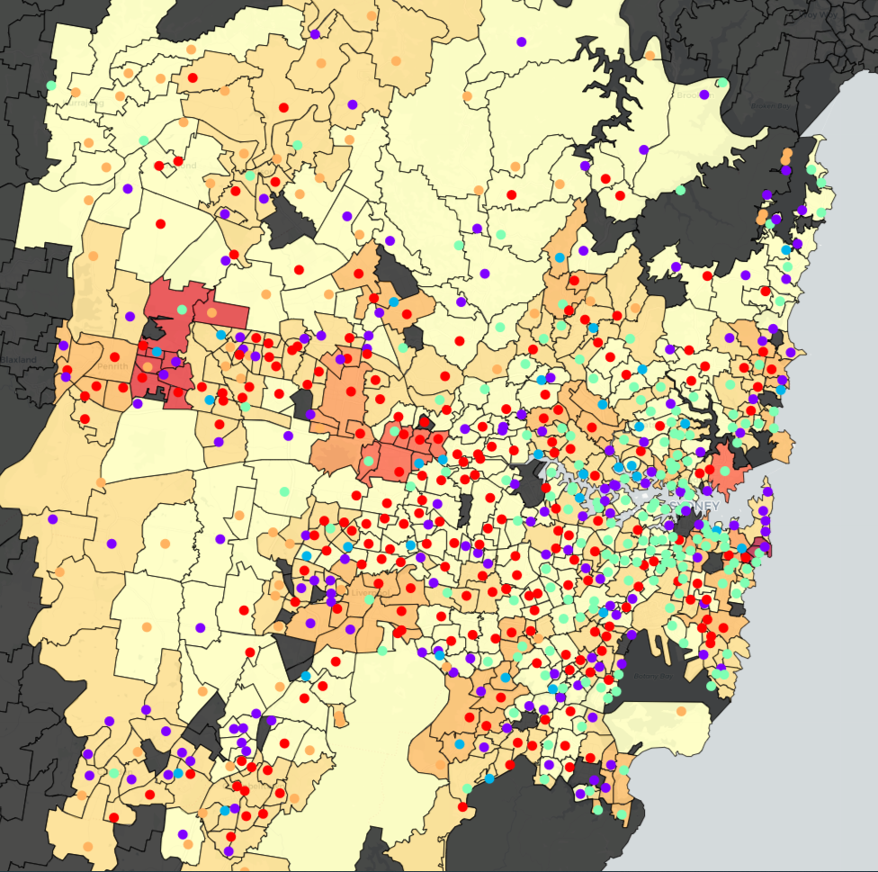
Cluster map with patient

Slide 8
Conclusion
Selected 7 suburbs for analysis
Girraween, Llandilo, and Pemulwuy have no restaurant
Mosman and Queens park only have a few restaurants
Bondi and Tamarama have more restaurants and COVID-19 patients compares to other suburbs

